Slide 1
Accident Severity Prediction with Machine Learning
IBM COURSERA CAPSTONE PROJECT
SURAJ KUMAR

Slide 2
INTRODUCTION
Accident is the ninth prominent cause of death in the world.
Almost half of those killed on the roads are “vulnerable users” (pedestrians, cyclists and motorcyclists).
Accurate prediction of accident severity can be helpful to provide proactive solutions to local governments.
The economic cost of road accidents to a developing country like us is 2-3% of GDP.
To analyse the road accidents and determines the severity of an accident by applying advanced machine learning technique

Slide 3
DATA
In this project, we develop machine learning models to predict severity of road accidents in Seattle based on data collected .
Data acquired from Seattle Police Department(SPD) and recorded by Traffic Records.
Dataset was downloaded as CSV file.
The raw sample has a total of 194673 accidents with 37 columns.
Timeframe : 2004 to Present.

Slide 4
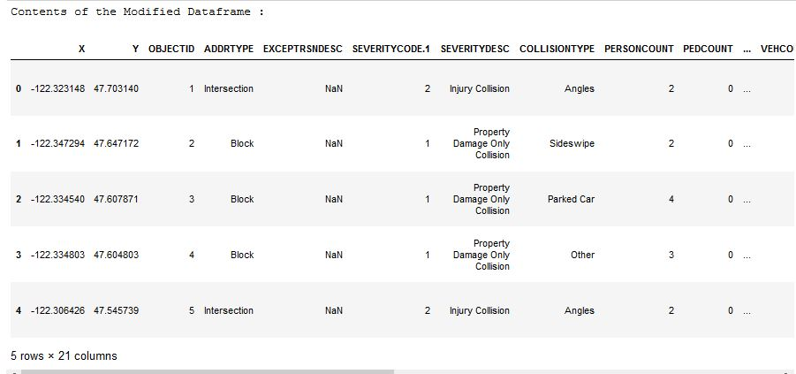
DATA EXPLORATION
Removing irrelevant attributes

Slide 5
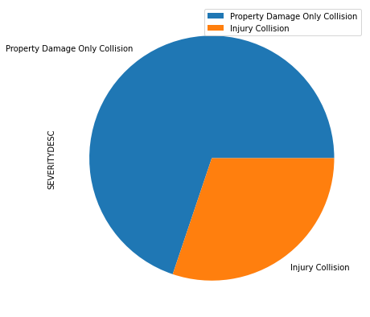
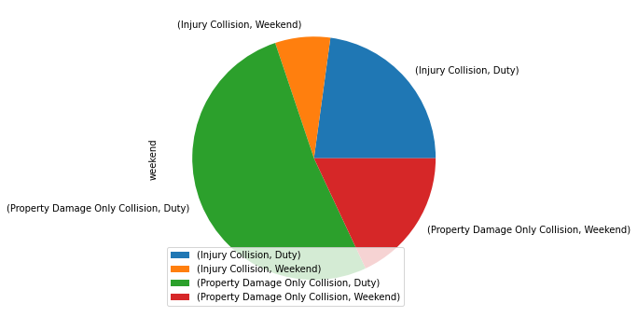
DATA PRE-PROCESSING
Severity Proportion
Weekends' and Severity Cases:

Slide 6
DATA PRE-PROCESSING
Removing irrelevant attributes

Slide 7
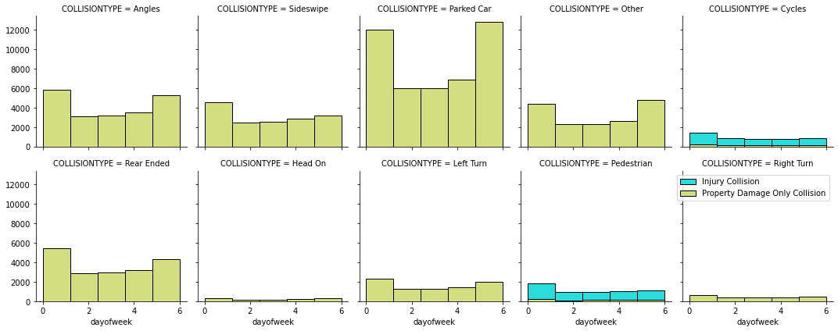
Different types of Collision and their respective counts day wise:

Slide 8
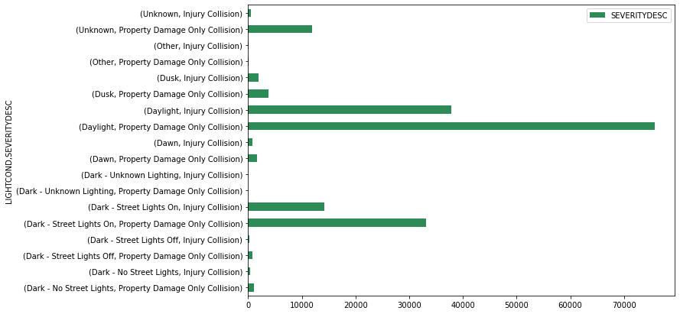
Light Condition and Severity Cases:

Slide 9
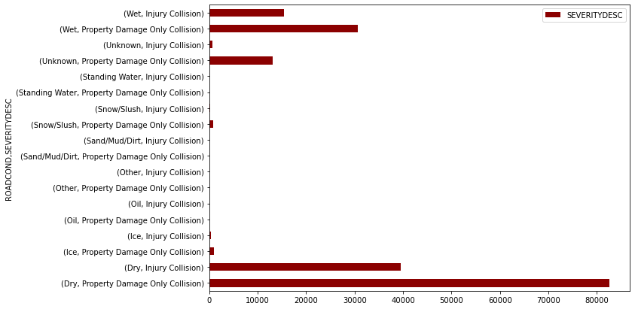
Road Condition and Severity Cases

Slide 10
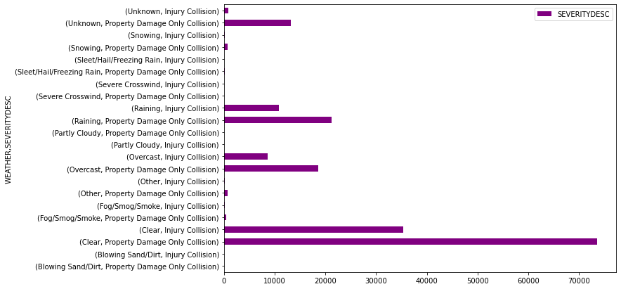
Weather and Severity Cases

Slide 11
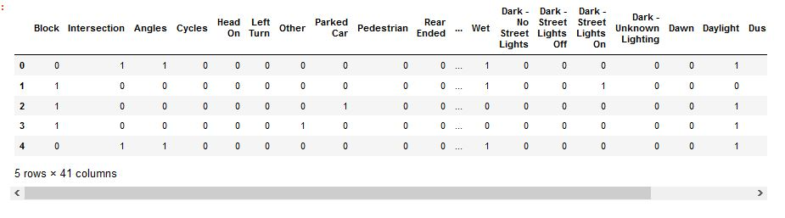
Feature Engineering: Convert attributes to categorical variable

Slide 12
MODEL BUILDING
Build 4 machine learning classifiers:
Decision Tree (DT)
K-Nearest Neighbour (KNN)
Support Vector Machine (SVM)
Logistic Regression (LR)
Data were splitted into 80% training data and 20% validation data.
For the best model, further evaluation will be performed using precision, recall, F1-score and support to evaluate the models.

Slide 13
ACCURACY OF BUILD MODELS.
Evaluation of classification performance of SVM model
Model | Accuracy | F1-Score | Jaccard Score
Decision Tree (DT) | 0.742 | 0.82 | 0.7028
K-Nearest Neighbour (KNN) | 0.727 | 0.79 | 0.6642
Support Vector Machine (SVM) | 0.734 | 0.8254 | 0.7028
Logistic Regression (LR) | 0.7325 | 0.8254 | 0.7028
 | Precision | Recall | F1-Score | Support
Injury Collision (0) | 0.69 | 0.19 | 0.30 | 597
Property Damage Only Collision (1) | 0.74 | 0.96 | 0.83 | 1403

Slide 14
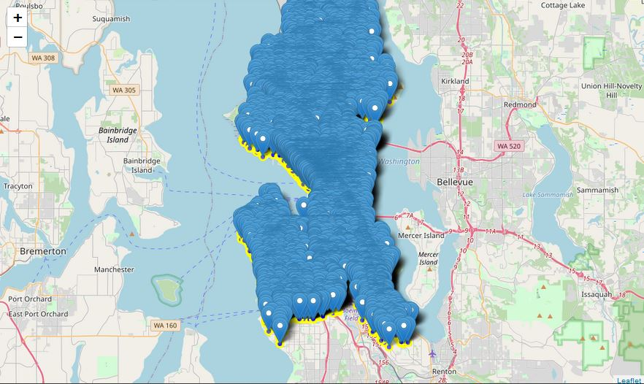
MAPPING OF COLLISION POINTS OVER SEATTLE MAP

Slide 15
CONCLUSION
In this project, we propose a machine learning model to predict the severity of traffic accidents in the city of Seattle.
A comparative approach was followed to identify the best performing model among 4 models.
Critical imbalance between the 2 severity classes
Further improvements are required to optimize the model performance.

